Slide 1


https://www.google.com
Server
Browser

Slide 2
index.html
script.js
style.css
image.jpg
https://www.google.com
Server
Browser

Slide 3



index.html
script.js
style.css
image.jpg
https://www.google.com
Server
Browser
The 3 Languages that browsers understand

Slide 4
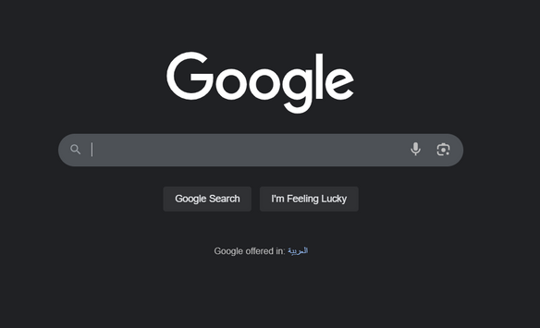
https://www.google.com
Server
Browser
Front-end Development
The 3 Languages that browsers understand

Slide 5
Home
About
Content
Others
Page 01
HTML
Next Slide

Slide 6
Home
Others
Page 05
About
Content
Page 02
What is HTML
Html → Hyper Text Markup Language.
HTML is a markup language that we use to structure and describe the content of a webpage.
A markup language is a set of markup tags or we call it elements that describe different types of content: paragraphs, links, headings, images, video, etc.

Slide 7
Page 05
Home
About
Content
Others
Page 03
HTML ELEMENT
Element
<p> Hello, World This is HTML</p>
opening tag: Name
of the element,
wrapped in < and >
Content: Content of the element, in
this example text. But it might be
another element (child element). Some
elements have no content (e.g. <img>)
Closing tag: Same as
opening tag, but with
a /. When element has
no content, it’s omitted

Slide 8
Page 05
Home
About
Content
Others
Page 04
HTML Document structure
<html> → Root of document
<head> → Metadata, title, links (things not visible in the browser window)
<title> Introduction to web development </title> → Page title in browser tab
</head>
<body> → All Visible content on the browser
<p>Welcome to HTML!</p>
</body>
</html>

Slide 9
Home
Others
Page 05
About
Content
Page 05
HTML Headings
Headings are defined with the <h1> to <h6> tags.
<h1> defines the most important heading (bigger font). <h6> defines the least important heading (smaller font).
<h1> headings should be used for main headings, followed by <h2> headings, then the less important <h3>, and so on.
Headings Are Important:
– Search engines use the headings to index the structure and content of your web pages.
– Users skim your pages by its headings. It is important to use headings to show the document structure

Slide 10
Home
Others
Page 05
About
Content
Page 06
HTML Text and Paragraphs
Paragraphs:
– The HTML <p> element defines a paragraph: <p> This is a paragraph. </p>
– With HTML, you cannot change the output by adding extra spaces or
extra lines in your HTML code. The browser will remove any extra spaces and extra lines when the page is displayed.
Line breaks:
– The HTML <br> element defines a line break.
– Use <br> if you want a line break (a new line) without starting a new paragraph.
Preformatted text:
– The HTML <pre> … </pre> element defines preformatted text.

Slide 11
Home
Others
Page 05
About
Content
Page 07
HTML Lists
Unordered lists:
– An unordered list starts with the <ul> tag.
– Each list item starts with the <li> tag.
<ul>
<li>Networks Dept.</li>
<li>Software Dept.</li>
<li>Multimedia Dept.</li>
</ul>

Slide 12
Home
Others
Page 05
About
Content
Page 08
HTML Lists
Ordered lists:
– An ordered list starts with the <ol> tag.
– Each list item starts with the <li> tag.
<ol>
<li>Networks Dept.</li>
<li>Software Dept.</li>
<li>Multimedia Dept.</li>
</ol>

Slide 13
Home
Others
Page 05
About
Content
Page 09
HTML Lists
The type attribute of the <ol> tag, defines the type of the list item marker: type="1“, type="A“, type="a“, type="I“, type="i“.
<ol type="1">
<li>Networks Dept.</li>
<li>Software Dept.</li>
<li>Multimedia Dept.</li>
</ol>

Slide 14
Home
Others
Page 05
About
Content
Page 10
HTML Lists
Nested Lists:
– List items can contain new list, and other HTML elements, like images
and links, etc.
<ul>
<li>Coffee</li>
<ul>
<li>Black tea</li>
</ul>
</li>
<li>Milk</li>
</ul>

Slide 15
Home
Others
Page 05
About
Content
Page 11
HTML Images
In HTML, images are defined with the <img> tag.
The <img> tag is empty, and does not have a closing tag.
Syntax:
<img src="url" alt="some_text" width="width" height="height">
The src attribute (Required) specifies the URL (web address) of the image.
The alt attribute (Required) provides an alternate text for an image, If a browser cannot find an image, it will display the value of the alt attribute.

Slide 16
Home
Others
Page 05
About
Content
Page 12
HTML Links
HTML links are hyperlinks. You can click on a link and jump to another document.
In HTML, links are defined with the <a> tag: <a href="url">link text </a>
The href attribute specifies the destination web address or local page (in the same website)

Slide 17
Home
Others
Page 05
About
Content
Page 13
HTML Links
Link Targets: The target attribute specifies where to open the linked document.
– blank - Opens the linked document in a new window or tab
– _self - Opens the linked document in the same window/tab as it was clicked (this is default)
– _parent - Opens the linked document in the parent frame
– _top - Opens the linked document in the full body of the window
– framename - Opens the linked document in a named frame
Example:
<a href="http://www.iti.gov.eg" target="_blank">ITI Website</a>

Slide 18
Home
Others
Page 05
About
Content
Page 14
HTML iframes
An iframe is used to display a web page within a web page.
An HTML iframe is defined with the <iframe> tag: <iframe src="URL"></iframe>
The src attribute specifies the URL (web address) of the inline frame page.
Use the height and width attributes to specify the size of the iframe. <iframe src="demo_iframe.htm" height="200" width="300"></iframe.
An iframe can be used as the target frame for a link.
<iframe src="demo_iframe.htm" name="iframe_a"></iframe>
<a href="http://www.w3schools.com" target="iframe_a"> W3Schools.com </a>

Slide 19
Home
Others
Page 05
About
Content
Page 15
Online References
www.w3schools.com
www.echoecho.com
www.quackit.com
www.htmlcodetutorial.com
www.htmlquick.com
www.htmldog.com
www.tutorialehtml.com/en/index.php
http://www.tutorialspoint.com/html
https://developer.mozilla.org/en-US/docs/Learn/HTML
https://developer.mozilla.org/en-US/docs/Web/HTML/Element

Slide 20

Home
About
Content
Others
Thank
You

